Slide 1
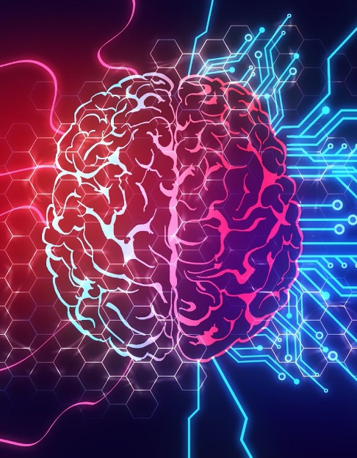
Selected - 2
Number Team : 47

Slide 2
Faculty Name : Computers and artificial intelligence Helwan
Team members’ IDs and names.
.1آلاء رضا عبدالحميد متولي 202000140
.2آية هاني قاسم توفيق 202000190
.3روان سعودى صلاح أحمد202000332
.4سارة سامح أبوبكر عبد الباسط 202000369
.5ميار أحمد السيد 202000965
.6هدى حامد مصطفى202001029

Slide 3
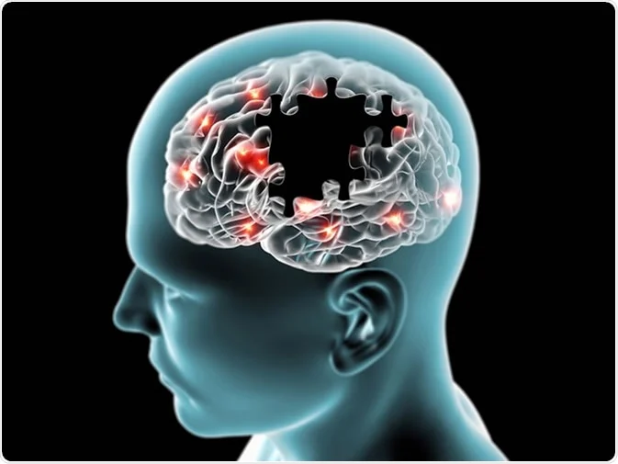
Paper details:
Authors name
Lamis F. Samhan, Amjad H. Alfarra, Samy S. Abu-Naser,
Ismail A.Amassi
paper name
Classification of Alzheimer's Disease Using Convolutional Neural Networks
year of publication
March – 2022
The dataset used
Alzheimer MRI Preprocessed Dataset (Kaggle)

Slide 4
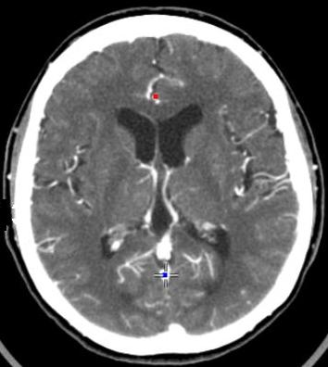
Paper Overview:
The paper "Classification of Alzheimer's Disease Using Convolutional Neural Networks" discusses the use of deep learning techniques to classify Alzheimer's disease using CT scans of the brain.
The authors explain that Alzheimer's disease is a progressive brain disease that affects memory and thinking skills, and it is important to classify memory loss and assess the patient's level of Alzheimer's disease.
The proposed method uses deep learning classification to improve patient care, reduce costs, and allow fast and reliable analysis in large studies.
Brain CT-Scan

Slide 5
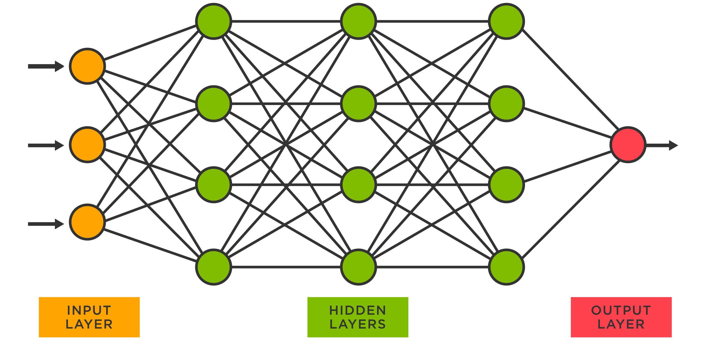
Paper Overview:
The authors implement a deep learning model to detect early Alzheimer's disease using a dataset of 10,432 images and 4 categories (Mild Demented, Moderate Demented, Non-Demented, Very Mild Demented). They use Python language to implement the system and use 70% of the images for training and 30% for validation. The trained model achieves an accuracy of 100% on a held-out test set.
The paper explains the concepts of machine learning and deep learning, and how deep learning uses hierarchical levels of artificial neural networks to learn from data. The authors discuss the importance of using deep learning techniques in medical diagnosis and image analysis, where it is difficult or infeasible to develop conventional algorithms to perform the needed tasks.

Slide 6
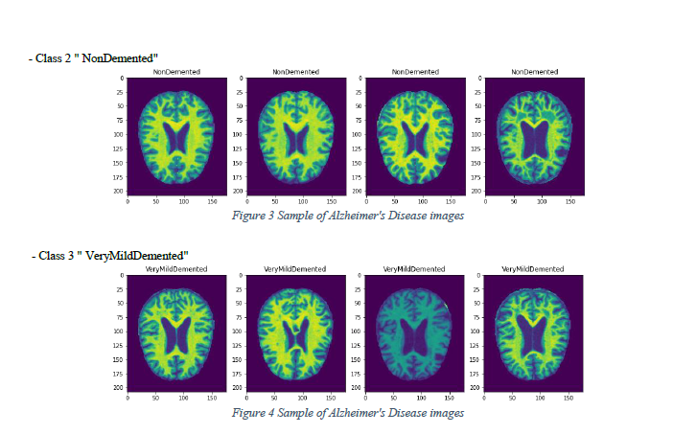
Paper Overview:
The paper provides a literature review of previous studies that have used deep learning techniques for the classification of Alzheimer's disease using medical imaging data, such as CT, MRI, and X-ray images. The studies discussed in the review demonstrate the potential of deep learning approaches in achieving high accuracy rates for Alzheimer's disease classification.
The methodology used in the paper involves implementing deep learning features for the classification of Alzheimer's disease through a dataset of 10,432 JPEG images and 4 categories (Mild Demented, Moderate Demented, Non-Demented, Very Mild Demented). The model is designed using Python language with Keras and TensorFlow libraries, and the system is supported by Graphics Processing Units (GPU) with NVIDIA to make the execution of deep learning algorithms faster.

Slide 7
Objectives
Develop a deep learning model for detecting four forms of Alzheimer's disease (Mild Demented, Moderate Demented, Non-Demented, Very Mild Demented) was implemented.
Avoid diagnostic errors that can arise when images are examined manually.
It helps clinicians make faster, more accurate diagnosis by improving their capacity to analyze medical images.

Slide 8
Project Description Document
the name of the dataset
Alzheimer MRI Preprocessed Dataset (Kaggle)
the link of dataset
https://www.kaggle.com/datasets/sachinkumar413/alzheimer-mri-dataset
the total number of samples in the dataset
The dataset consists of 6400 MRI images
the dimension of images
128*128
number of classes and their labels
Class1: Mild Demented (896 images).
Class2: Moderate Demented (64 images).
Class3: Non Demented (3200 images).
Class4: Very Mild Demented (2240 images).

Slide 9
Implementation Details:
Ratio for
number of images
Training :
validation:
Training : 5120
validation: 1280
80
20

Slide 10
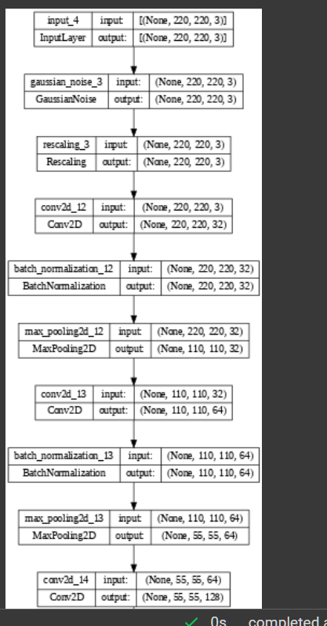
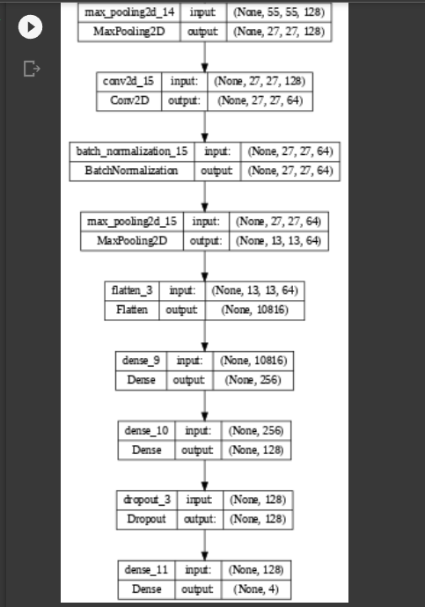






block diagram

Slide 11
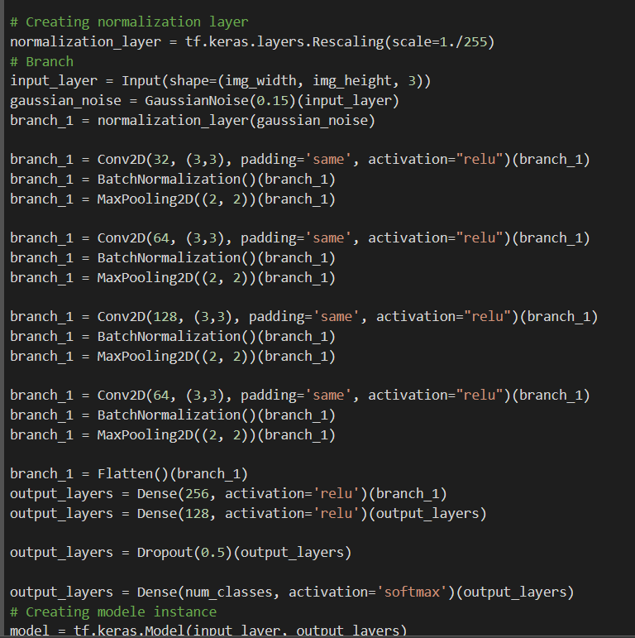
Hyperparameters used:
Model used:
Activation= relu ,softmax
learning_rate = 1e-4
Optimizer : adam
Batch_size = 32 batch
No. of Epochs= 10 Epoch.

Slide 12
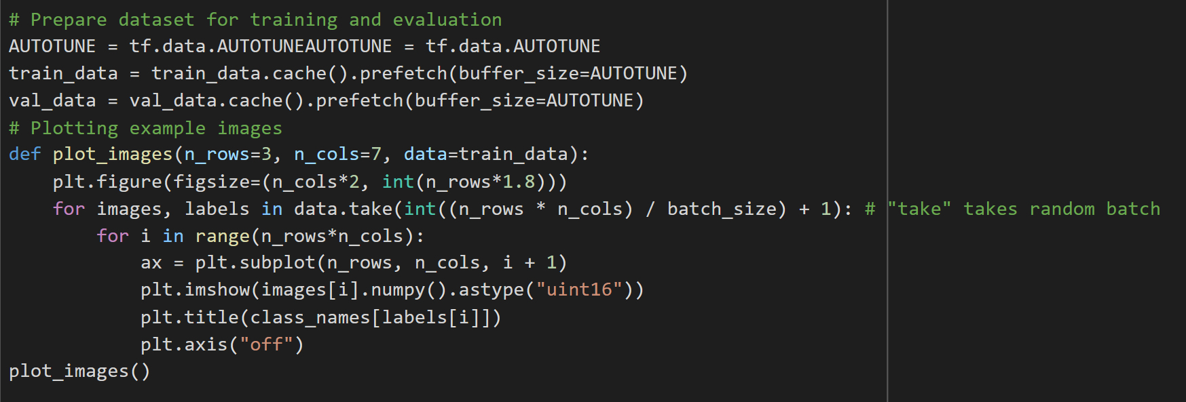
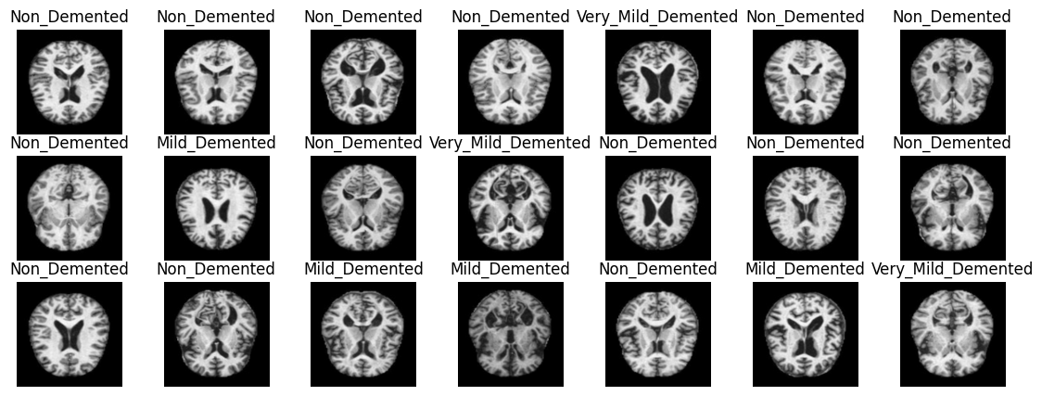
Example image:

Slide 13
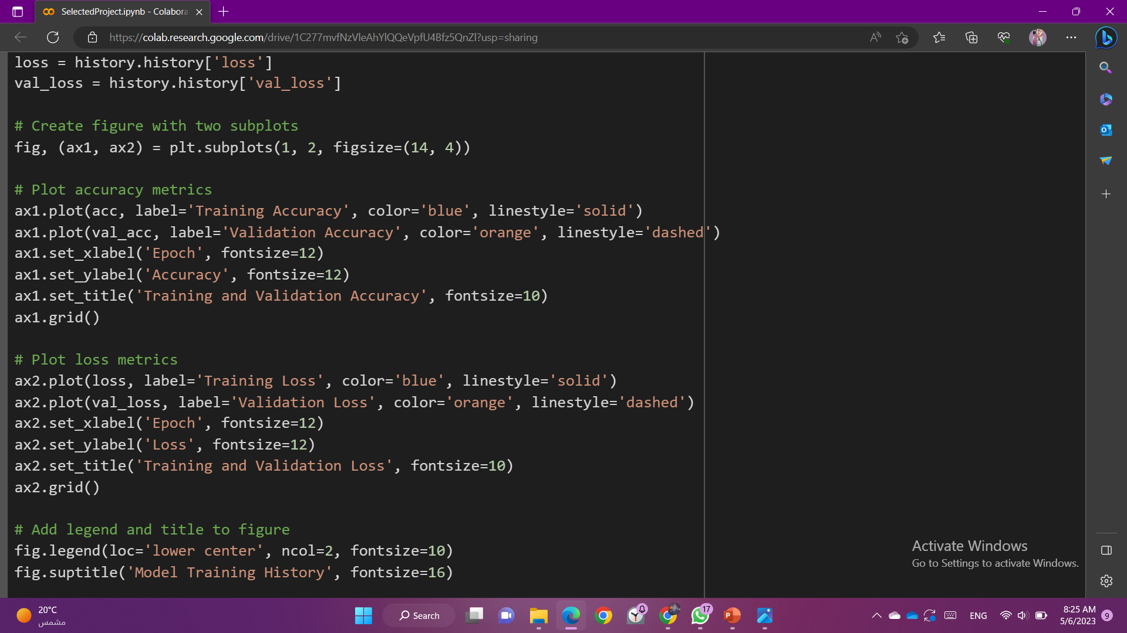
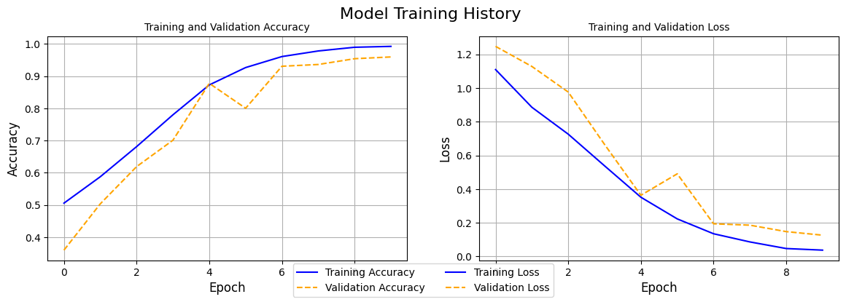
Results Details:
1 - Training Loss & Validation Loss

Slide 14
2 - Training Accuracy & Validation Accuracy

Slide 15
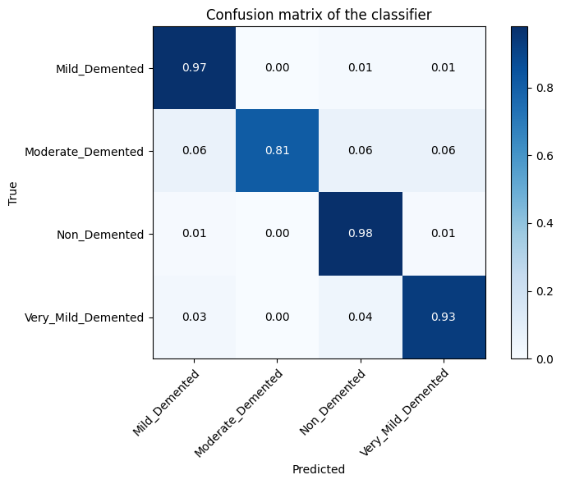
1. Confusion Matrix:

Slide 16
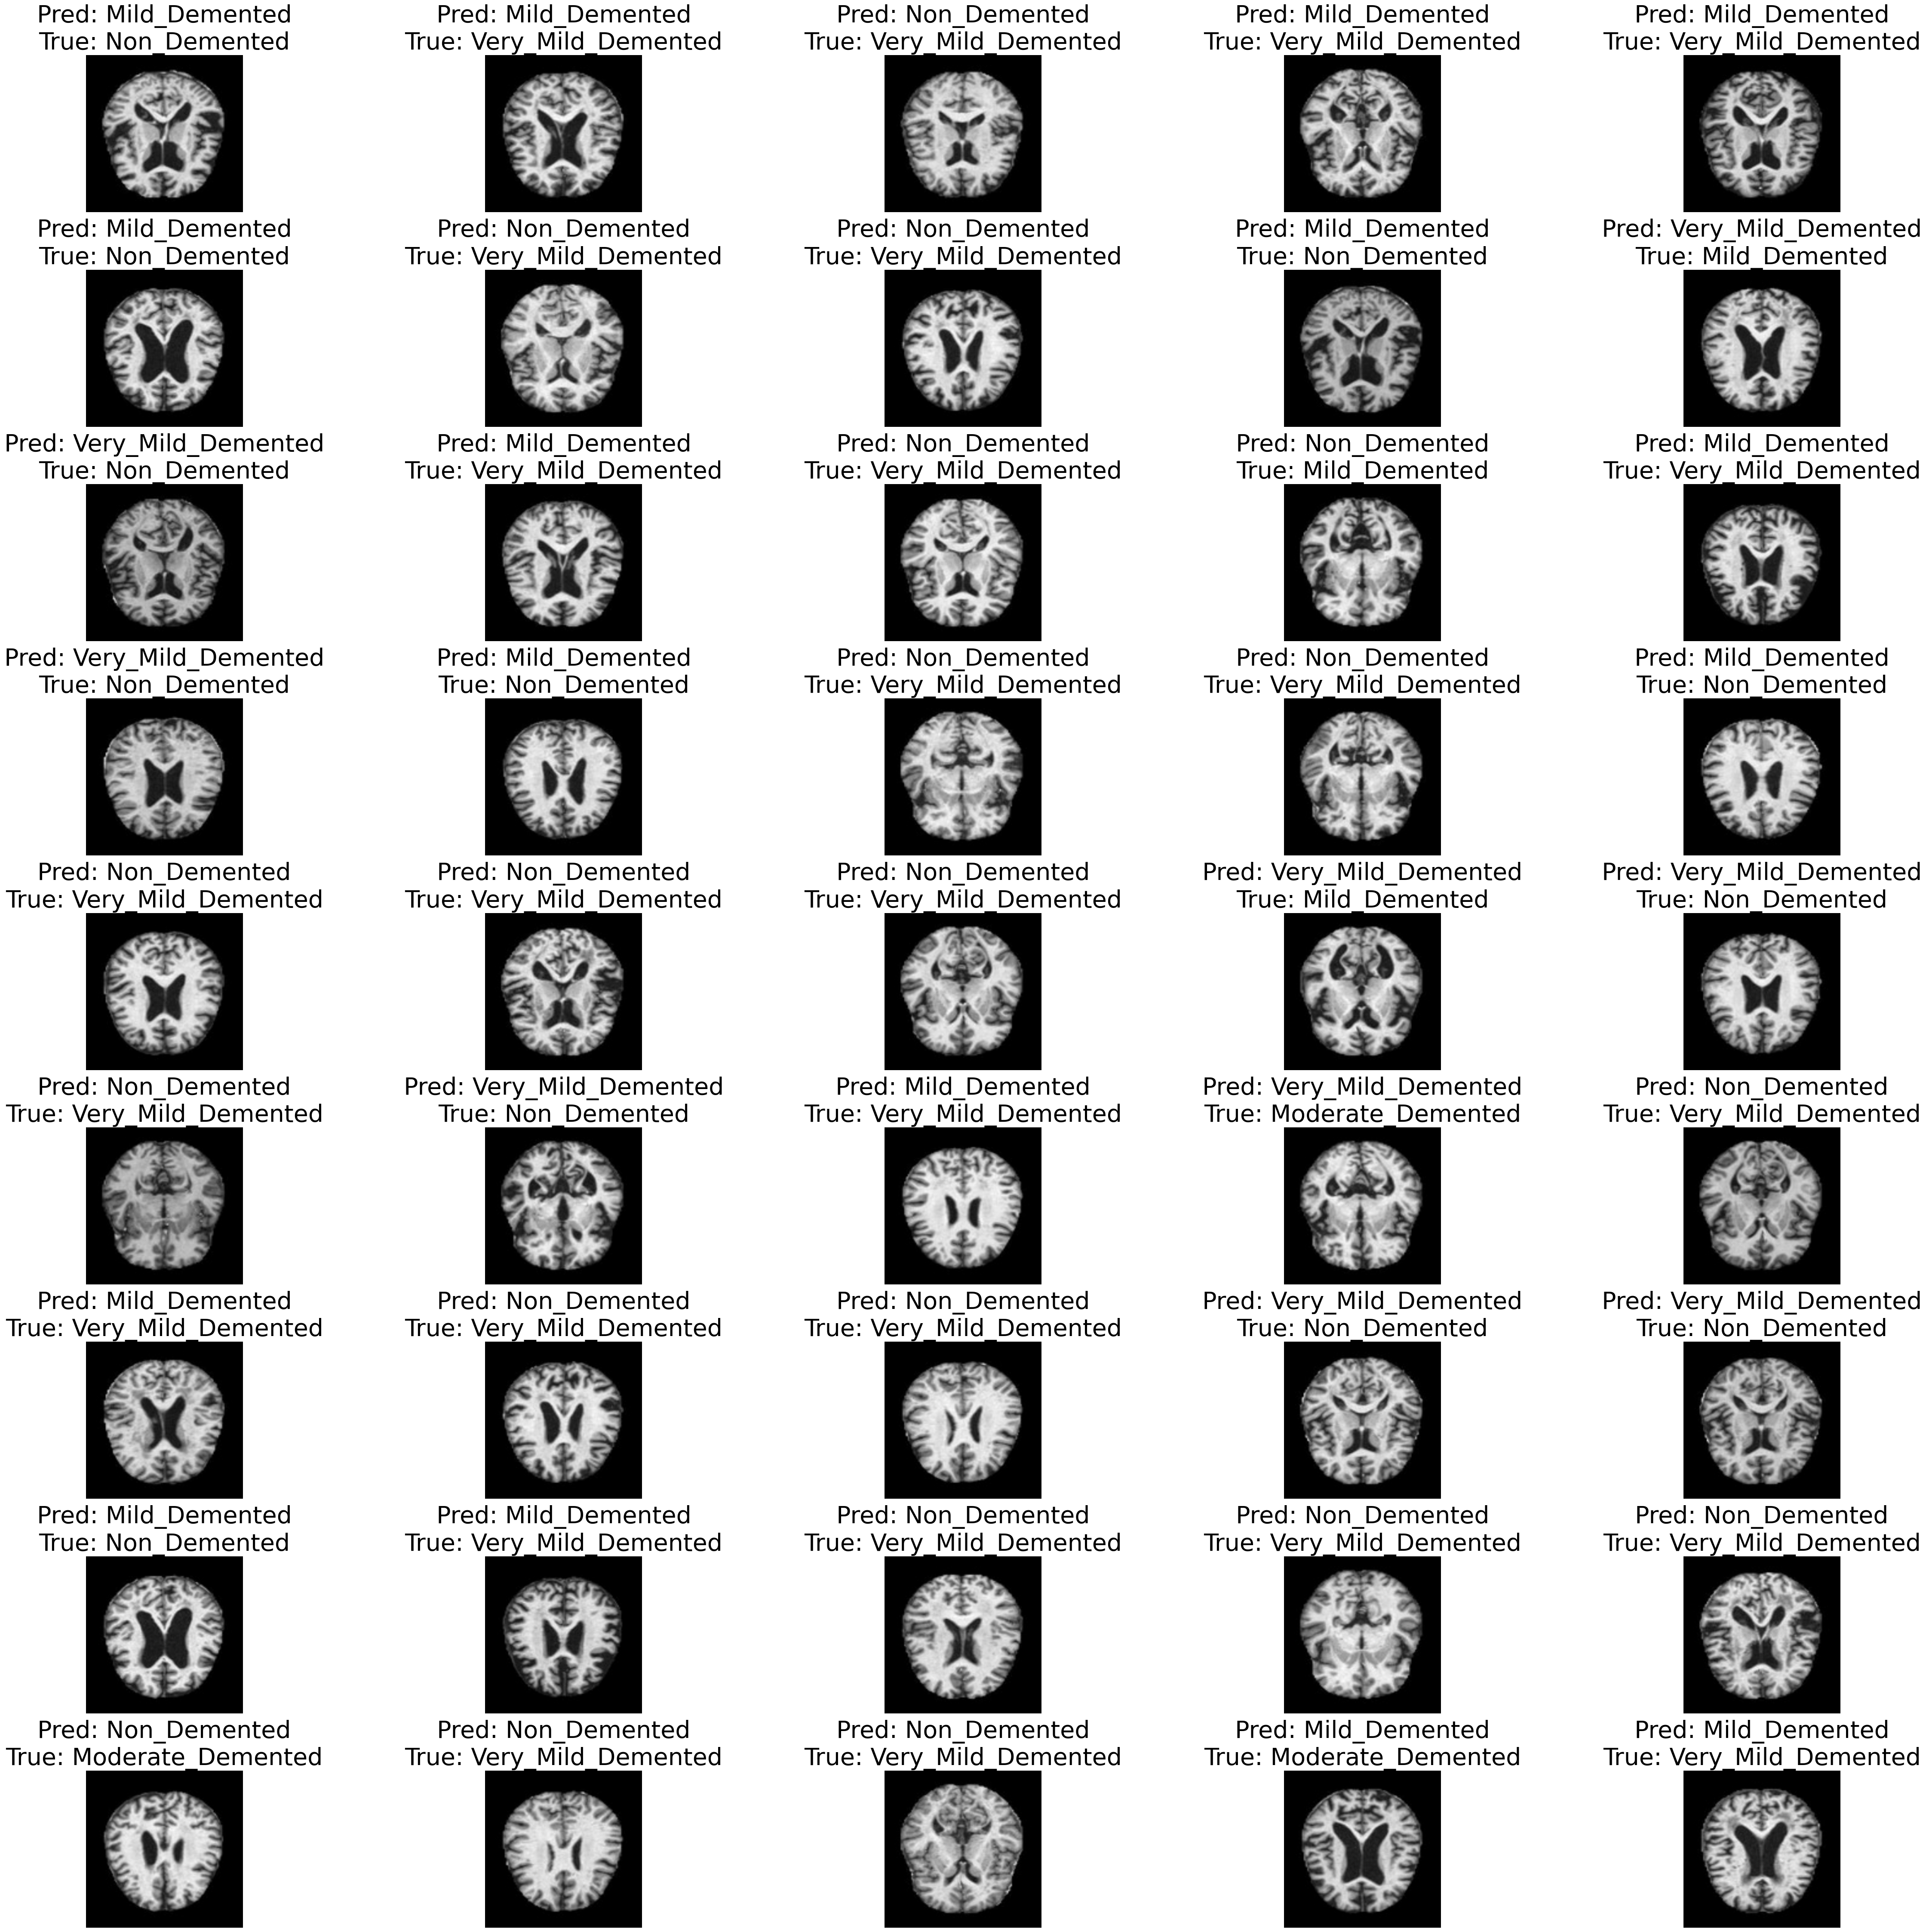
Prediction

Slide 17
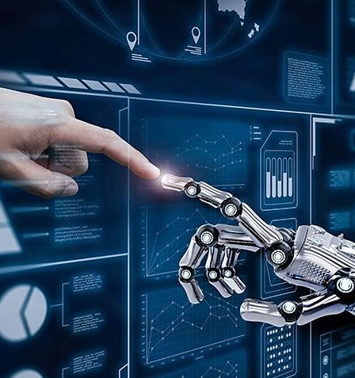
Thank you

